Slide 1
College ERP System
You will be able to find your future with us

Slide 2
Online College Platform (ERP)
KIET GROUP OF INSTITUTE, GHAZIABAD,
UTTAR PRADESH
Submitted To -
(DR. A.P.J. ABDUL KALAM TECHNICAL UNIVERSITY,
LUCKNOW, UTTAR PRADESH, INDIA)
Guided by -
Mr. VIDHUSI MAM
Submitted by -
GAURAV PANWAR (2000290140047)
PIYUSH CHAUDHARY (2000290140085)
HARSHIT TYAGI (2000290140050)
ABHINAV SHARMA (2000290140005)

Slide 3
Contents
Introduction
Requirement Specifications
Scope of the Project
Modules of the System
Demonstration
Future Enhancement
Conclusion

Slide 4
Introduction
This is a web application allows us to access the whole information about the college, staffs, students, facilities etc.
This generic application designed for assisting the students of an institute regarding information on the courses, exams, grades, attendance and exam-timetable.
It also provides support that a faculty can also check in, can create exams, prepare questions for Exams, and takes Attendance.
Here administrator will manage the accounts of the faculties, checks the overall performances of students.
Students can give Online Exams According to the Schedule and check their results, attendance, pending fee on their Dashboard

Slide 5
Requirement Specifications
Frontend :- Html, Css, Javascript
Backend :- Adv. Java
Database :- MySql
Web Server :- Tomcat 9.0
Hosting Site :- Heroku
Software :- Eclipse IDE

Slide 6
Scope of the Project
College Information: Getting information about the college campus such as courses available, Infrastructure etc.
Student attendance status: It gives the attendance status of students. Faculty will update the attendance periodically and can be seen by students.
Online Exams: Students can give online exams, it provides portability and calculating their performance as well. Online Exam Schedule is present on Student Dashboard.
Fee Management: Fee Admin can login for submitting fee of students and get details of students with pending fee.
Faculty Dashboard: Faculties can login for Creating exams, questions, Updating details, taking attendance etc.
Student Dashboard: Students can see their data such as attendance, pending fee, results, exams schedule etc.

Slide 7
Modules of the System
Admin:-
Registering Faculties
Getting students information
Fee Admin:-
Submit Fee
Pending Fee Student details
Getting students information
Faculty:-
Creating Exams, Questions
Updating Details
Taking Attendance
Getting Exams information
Students:-
Exam Schedule
Online Exams
Attendance/Fee Status
Results of Exams

Slide 8
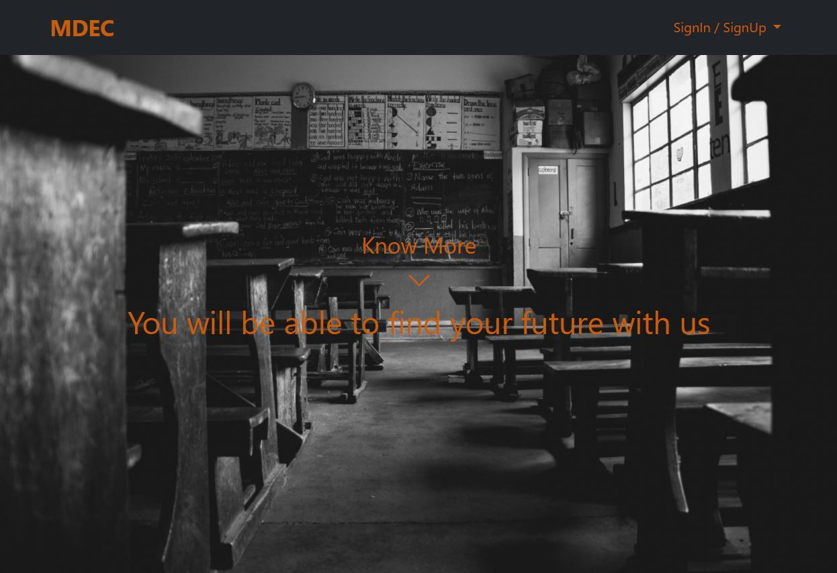
Demonstration
1. Website

Slide 9
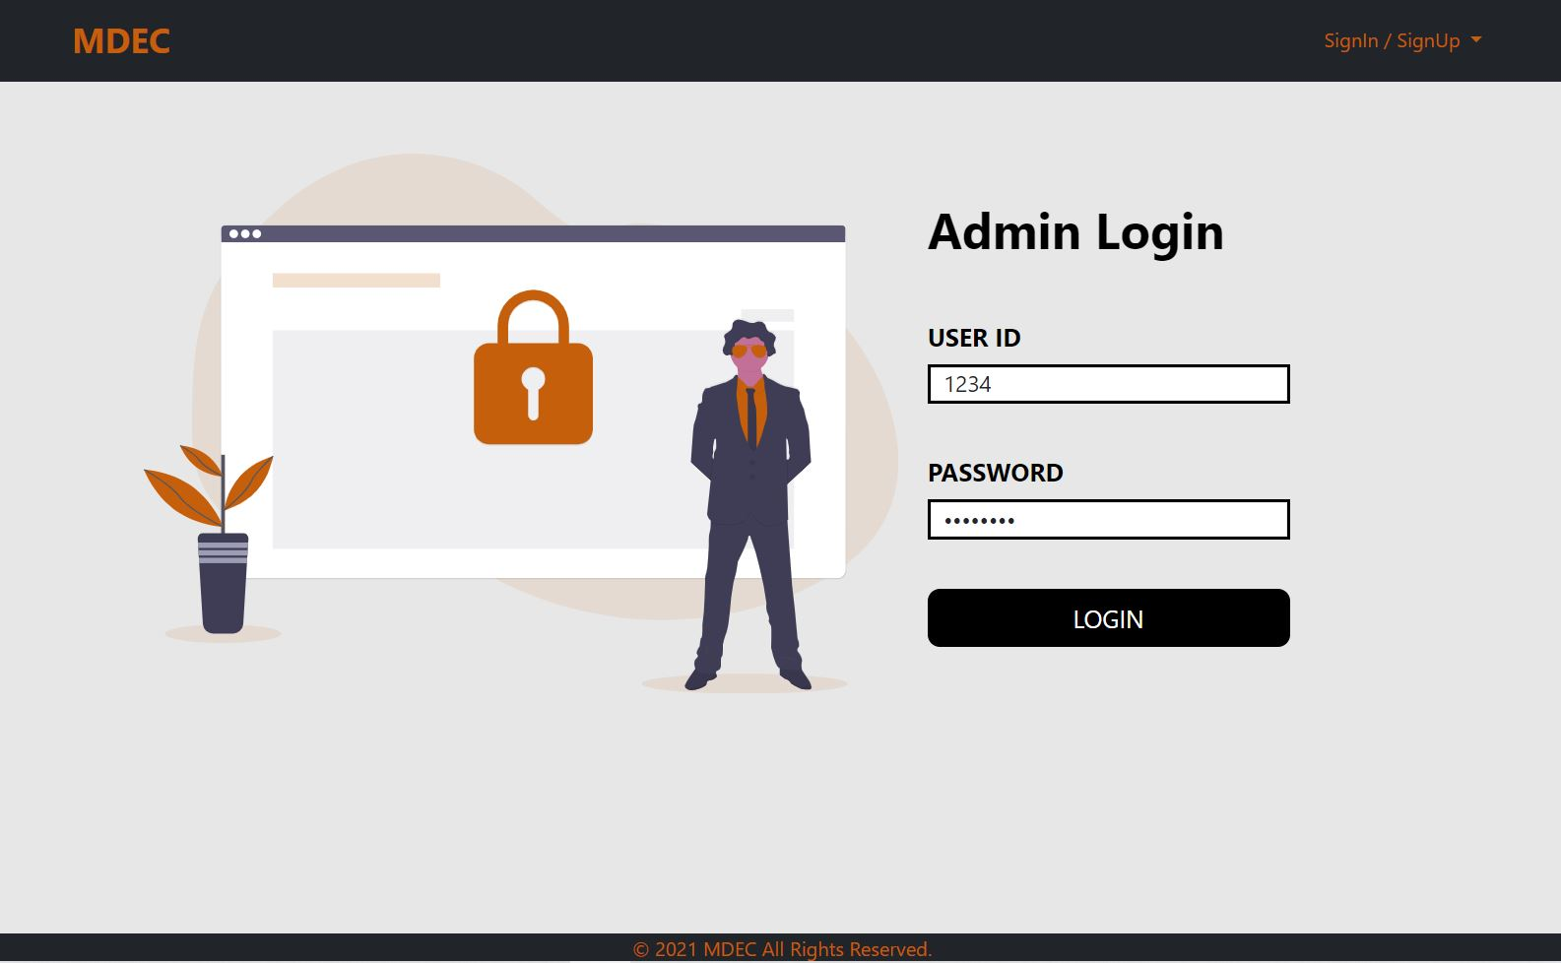
Demonstration
2. Login Page

Slide 10
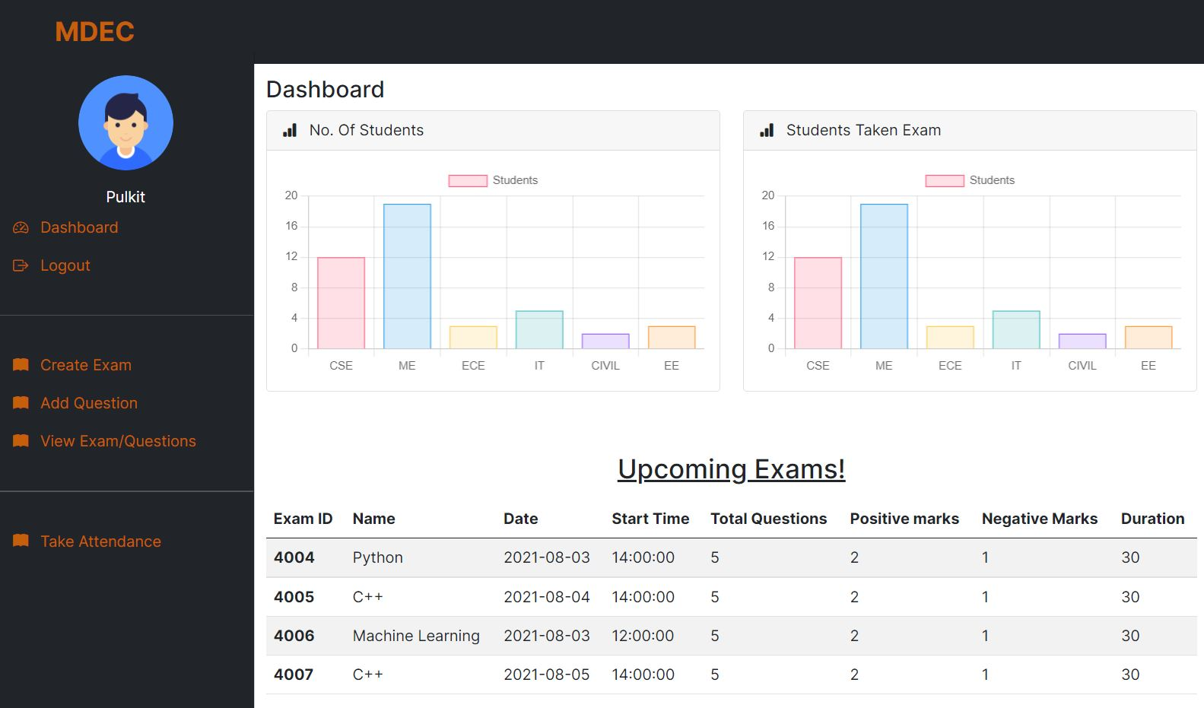
Demonstration
3. Faculty Dashboard

Slide 11
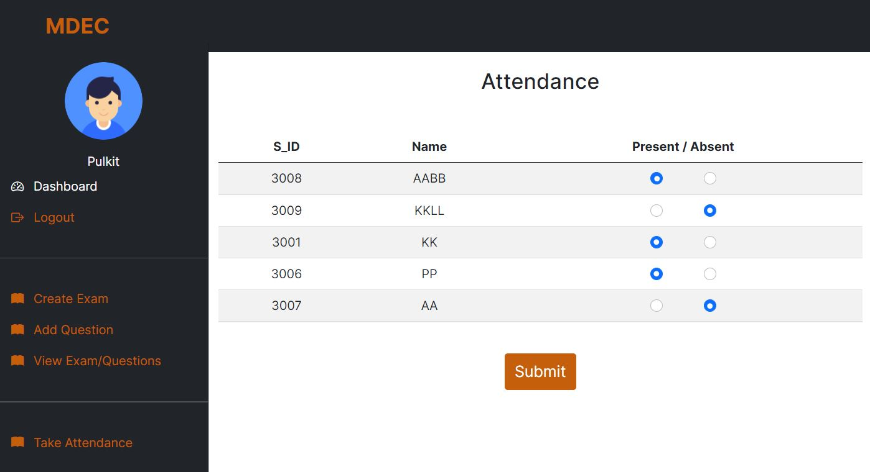
Demonstration
4. Attendance Page

Slide 12
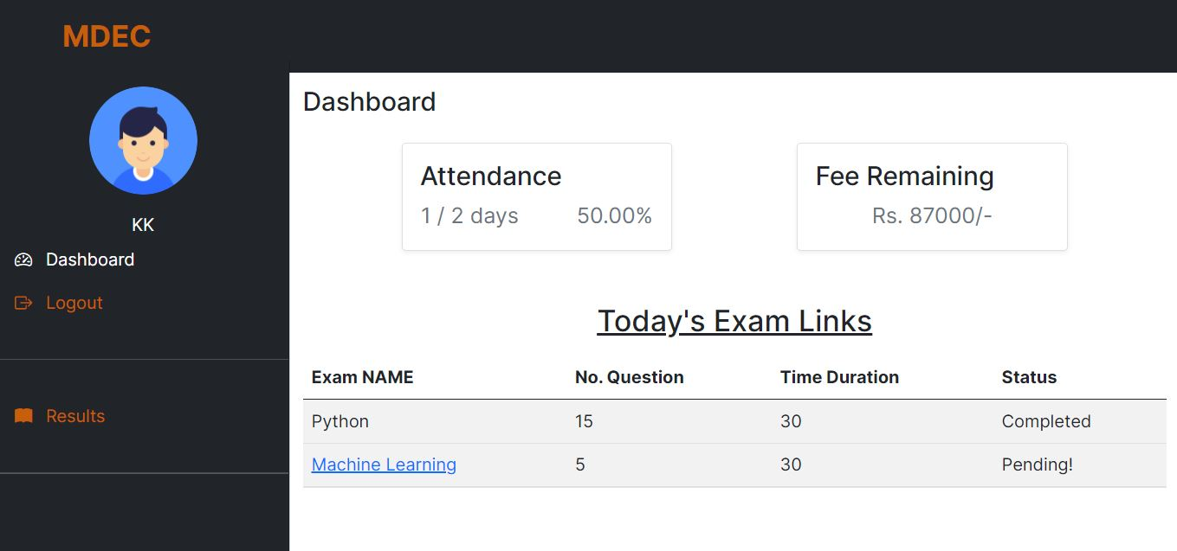
Demonstration
5. Student Dashboard

Slide 13
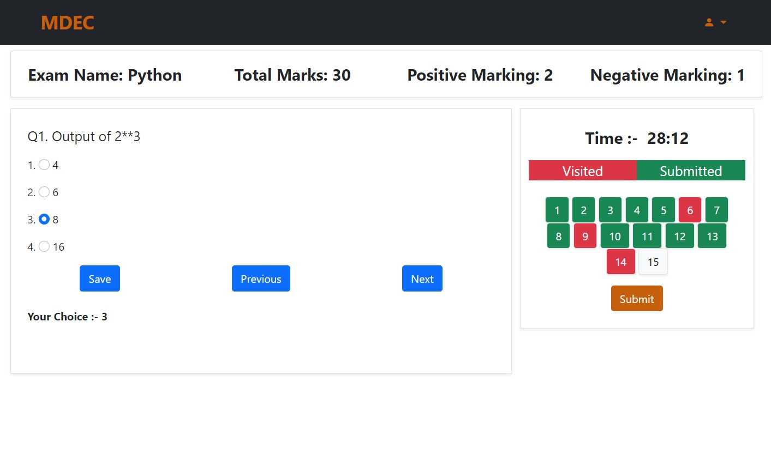
Demonstration
6. Exam Page

Slide 14
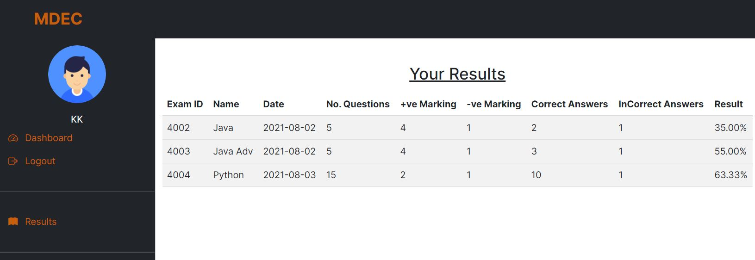
Demonstration
7. Results Page

Slide 15
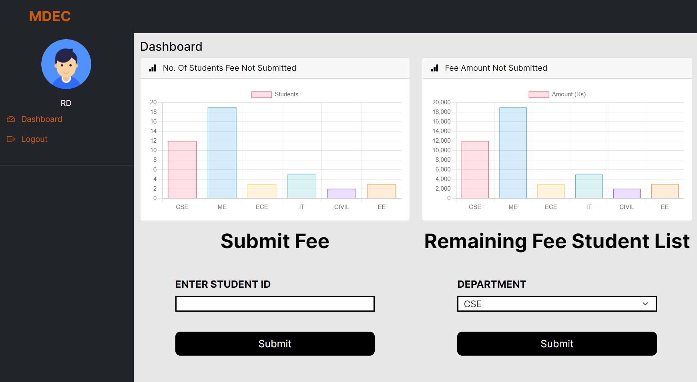
Demonstration
8. Fee Admin

Slide 16
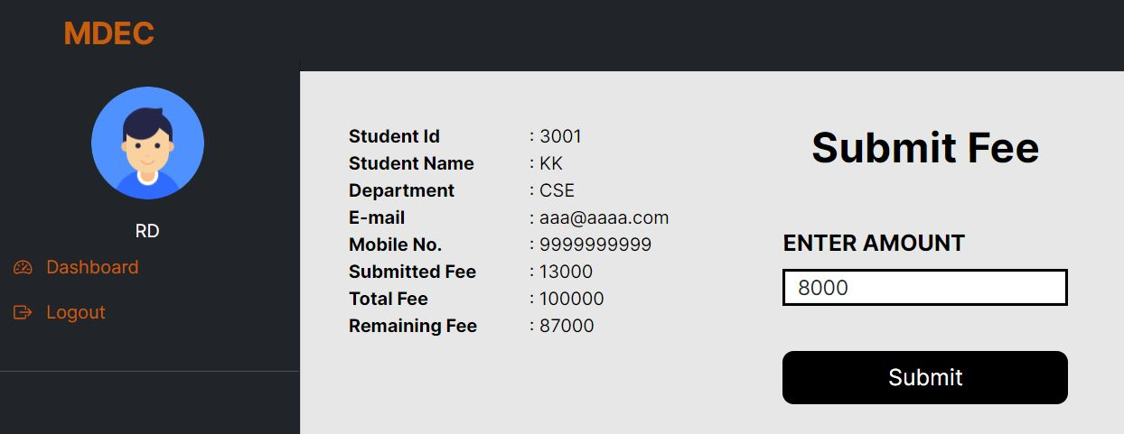
Demonstration
9. Fee Submit Page

Slide 17
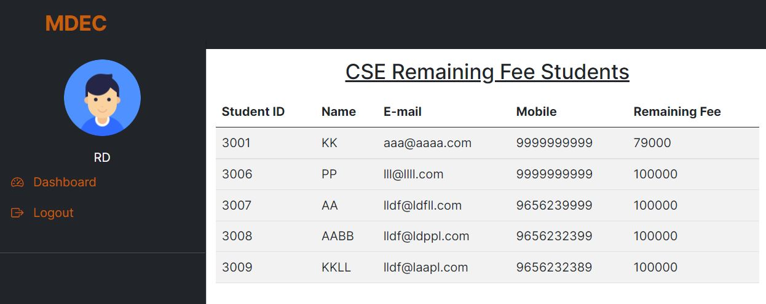
Demonstration
10. Remaining Fee Student List

Slide 18
Future Enhancement
Live Lectures can be implemented so that students can attend live lectures from anywhere.
Scheduling of the staff. i.e. , time table setting of the staff
Further, the faculty can upload the videos of their lectures on to this site and students who had missed those classes can view those videos.

Slide 19
Conclusion
The project entitled as College ERP System is the system that deals with the issues related to a particular institution.
This project is successfully implemented with all the features mentioned in system requirements specification.
The application provides appropriate information to users according to the chosen service.
The project is designed keeping in view the day to day problems faced by a college. ➢
Deployment of our application will certainly help the college to reduce unnecessary wastage of time.
Awareness and right information about any college is essential for both the development of student as well as faculty. So this serves the right purpose in achieving the desired requirements of both the communities.

Slide 20
Thank You!

